Slide 1

Loan Default Prediction for Dummy Irish Bank
Dharmik Kothari
Soham Adhikari
Yash Pasar
IST 718 – BIG DATA ANALYTICS
Prof. Willard Williamson

Slide 2
Project Overview
A loan is one of the most important source of revenue for a bank
Not all the loans are good, some customers behave negatively after their application are approved
To prevent the bank from investing in bad loans, we used machine learning algorithms to help the bank identify key factors that correspond to a loan
Objective:
Predicting good and bad loan

Slide 3
Data Description
Features
Id
Year
Issue Date
Final Date
Emp Length
Home Ownership
Home Ownership Cat
Income Category
Annual Income
Income Cat
Features
Loan Amount
Term
Term Cat
Application Type
Application Type Cat
Purpose
Purpose Cat
Interest Payments
Interest Payment Cat
Loan Condition
Features
Loan Condition Cat
Interest Rate
Grade
Grade cat
DTI
Total Payment
Total Rec principle
Recoveries
Installment
Region
Observations
887,380
Features
30

Slide 4
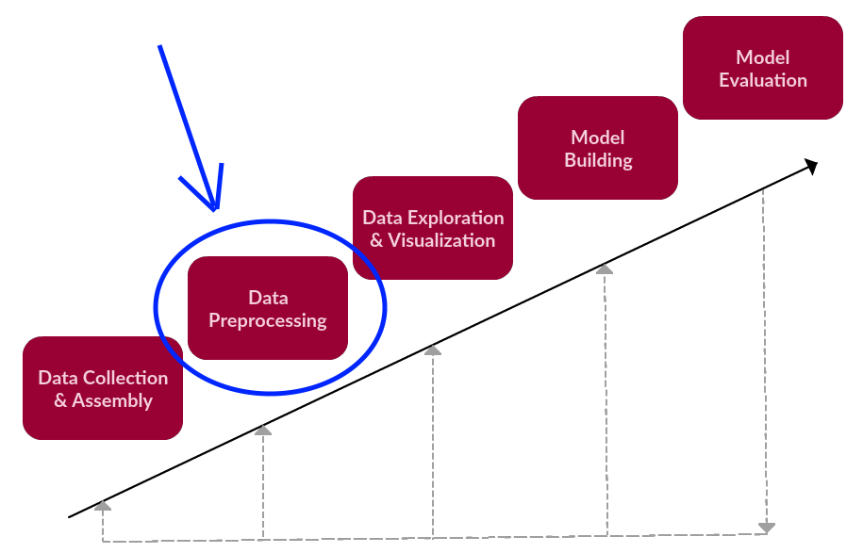
Data Preprocessing
Dummy variables were created, and one hot encoding was used

Slide 5

Exploratory Data Analysis

Slide 6
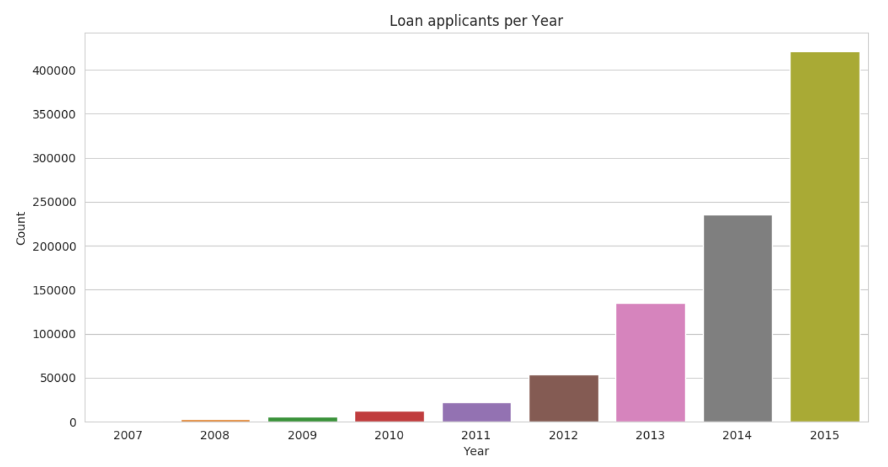
Loan Applications per year
The data set consists years from 2007 to 2015
We notice that the number of loan applicants are increasing exponentially

Slide 7
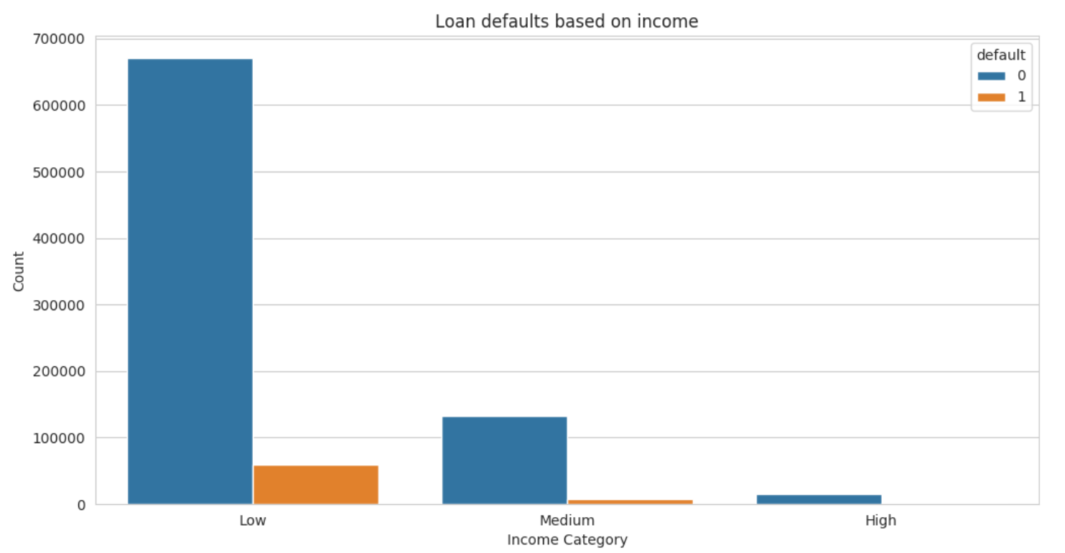
Loan Defaults based on Income
The data set consists three different categories of income
People with lower income apply the most for loans and also have high default count

Slide 8
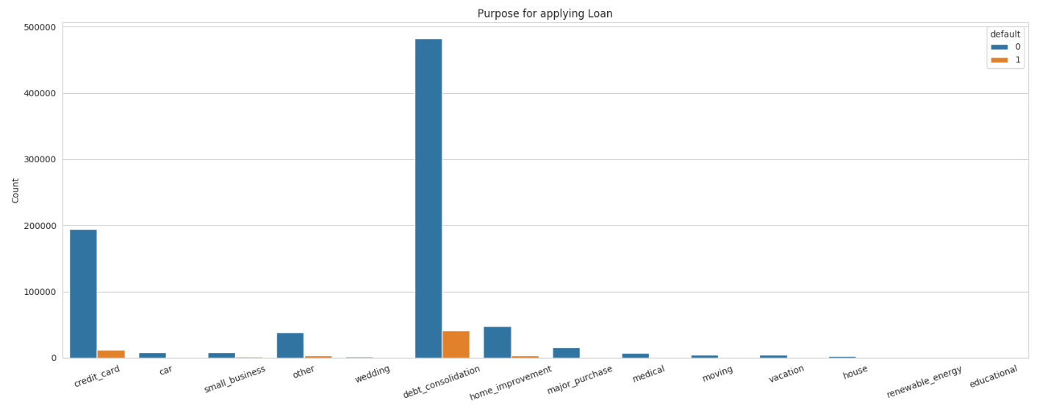
Reasons why people apply for Loan
There are about thirteen categories why people apply for loans
The major reasons for applying loan are credit card repayment and debt consolidation

Slide 9
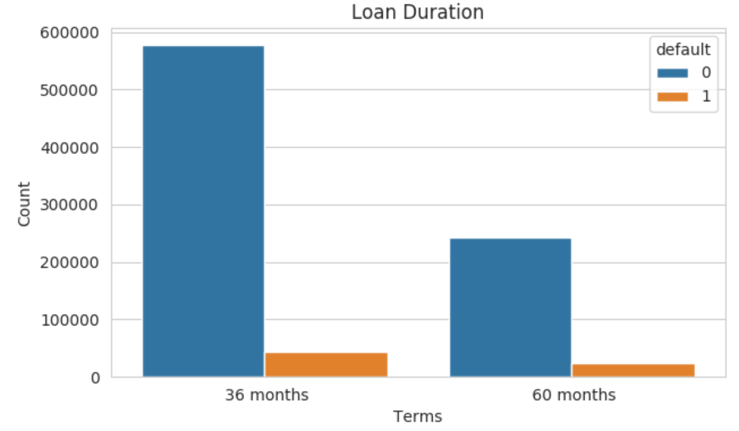
Loan Term Duration
The loan is available in two different terms either for 36 months and 60 months
People prefer shorter loans over long term loans

Slide 10
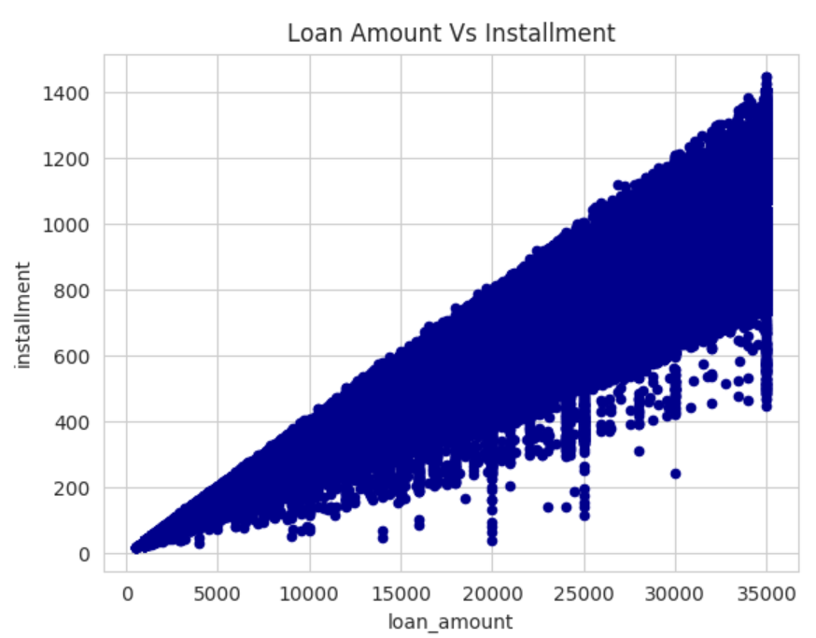
Loan Amount VS Installment
The range of the loan amount varies from 0 to 35,000
The range of the installment varies from 0 to 1400
As we would expect, the installment amount and the loan amount are co-related

Slide 11
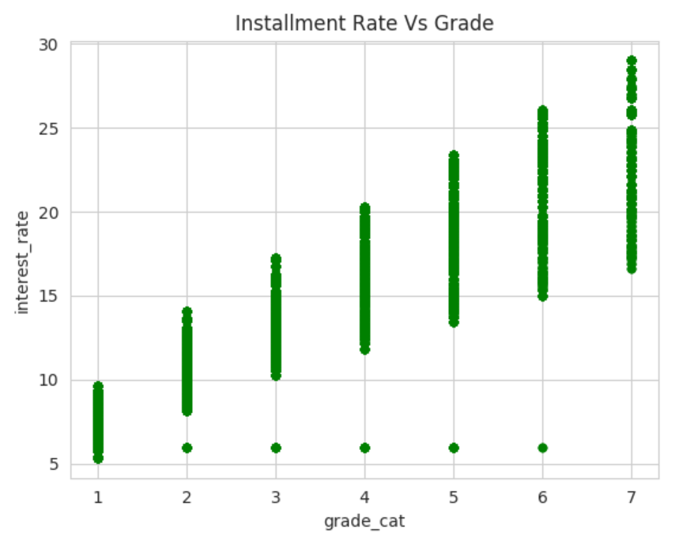
Interest Rate Vs Grade
Better the grade, lower the interest rate
Few outliers, can be observed where the interest rates have been lower

Slide 12
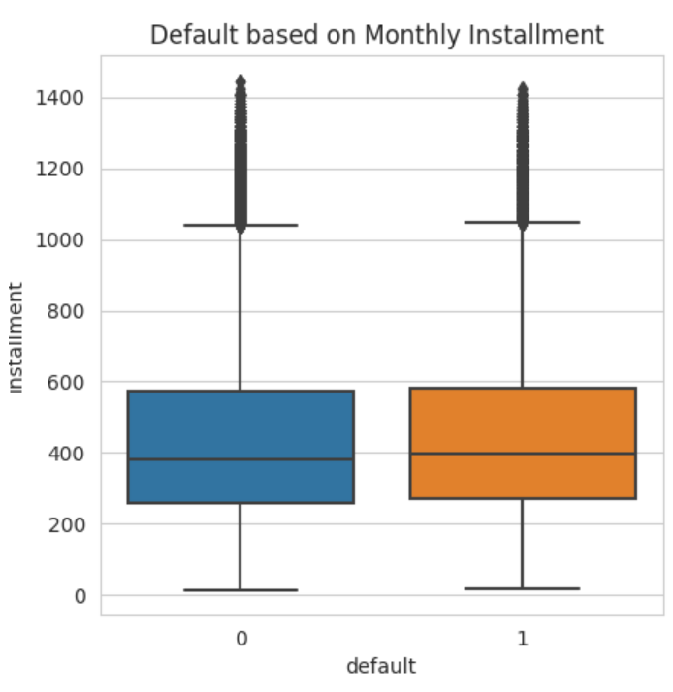
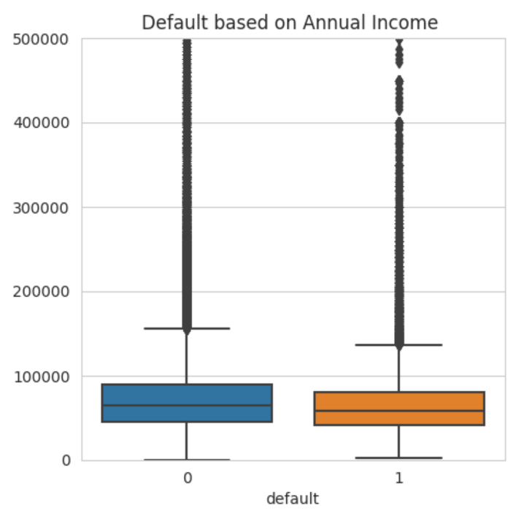
Finding Outliers based on Income and Installments
There are more outliers on defaults based on annual income
There are fewer outliers on defaults based on Monthly installments

Slide 13
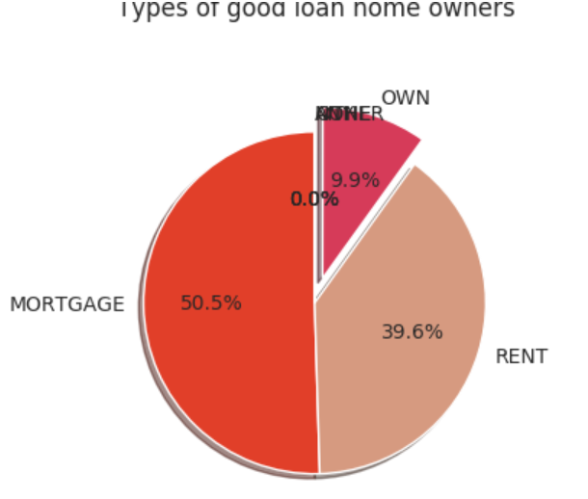
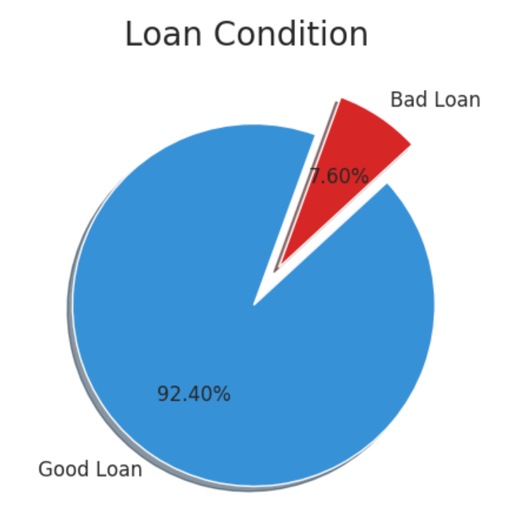
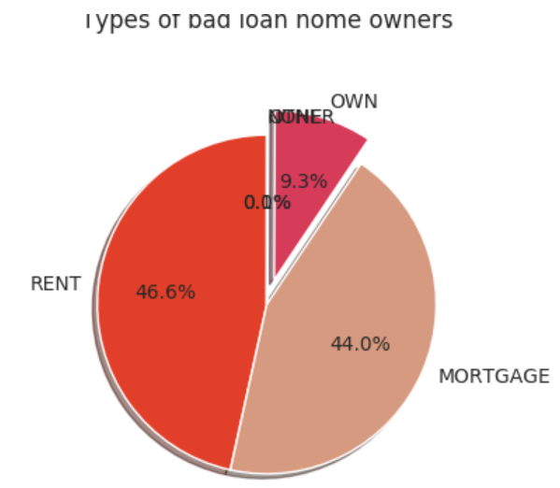
Homeowner type based on a good loan and a bad loan
Most people with a bad loan have a rented house
Most people with a good loan have a mortgage
The bad loans account up to 7.6% of total Loan

Slide 14
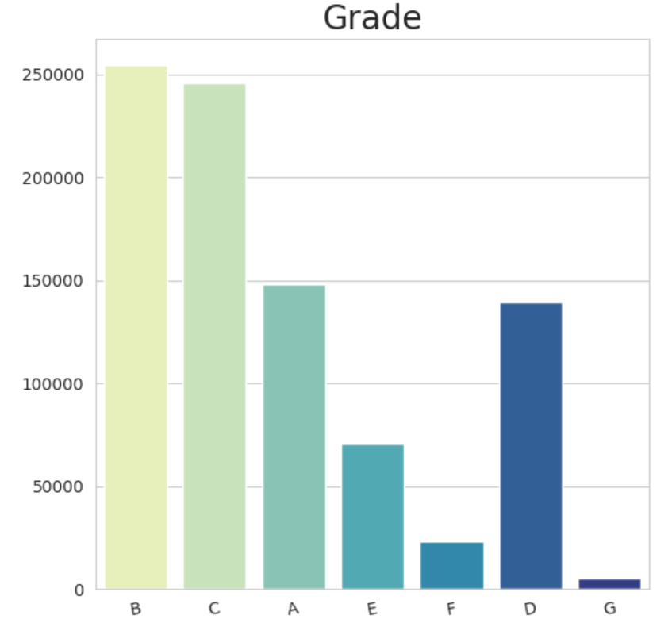
Number of loan applicants based on Grade
People with higher grades have more loan applicants

Slide 15
Feature Engineering
Predict if a loan is a good loan or a bad loan
The data was split into three parts for training, validation and testing purposes
Training set: 60% of the data
Validation set: 30% of the data
Test set: 10% of the data
Created Dummy variables for the categorical features to eliminate ordinal ranking
Created one common large feature group for modeling, based on correlation matrix and data profiles
For e.g. Total Payment, loan amount, installment, interest rate, Home ownership, grade etc.

Slide 16
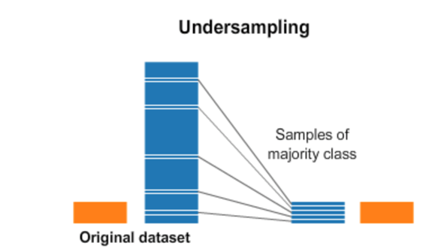
Handling Class Imbalance
Method 1: Undersampling of the data
- Out of 887,380 rows around 7.6% are bad loans which indicated an evident case of class Imbalance.
- Undersampling was performed in order to handle this situation by equating the proportions of Good Loans and the bad loans

Slide 17
Models Used
Logistic Regression
Decision Tree
Random Forest Classifier

Slide 18
Logistic Regression
Goal: To Predict “Good” and “Bad” loans
Logistic Regression was used as the initial predictive model
Features used: Total Payment, Loan Amount, DTI, Installment, Total Recovery Principle, Interest Rate, Grade, Home Ownership, Purpose and Term
Result:
The AUC score on default model: 76%
The AUC score on Grid Search best Model: 79%

Slide 19
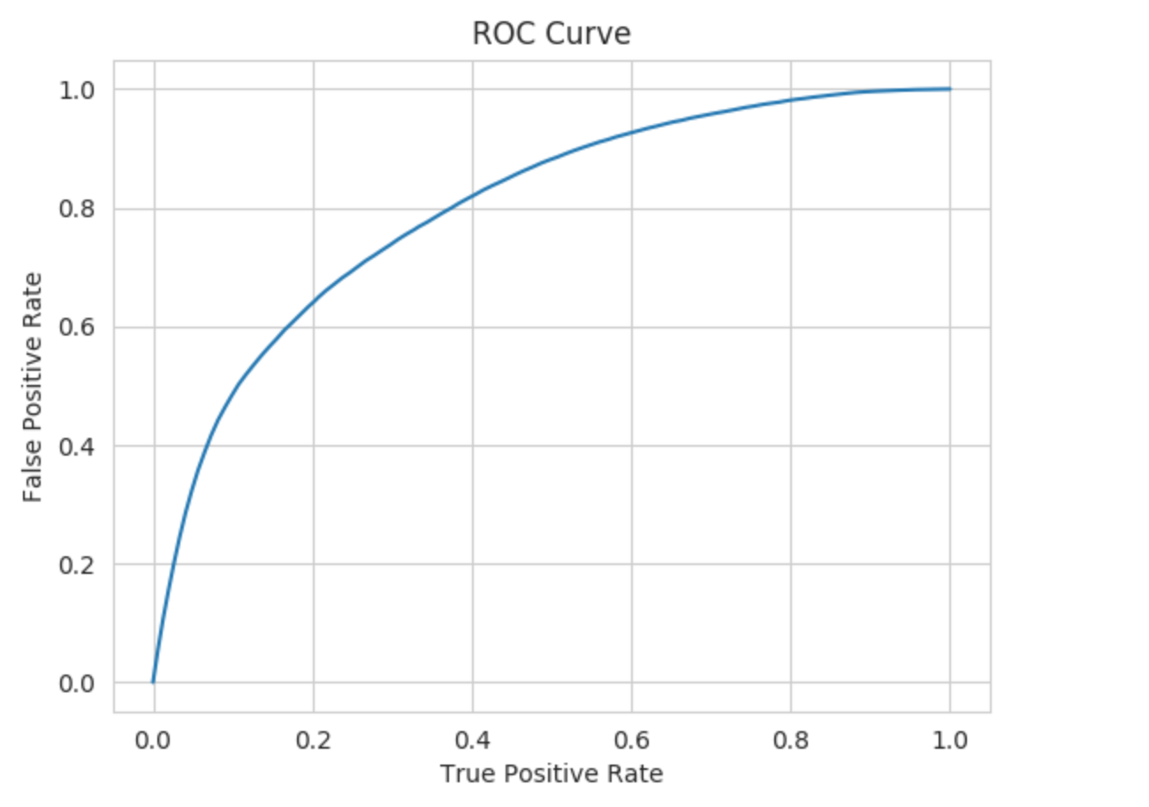
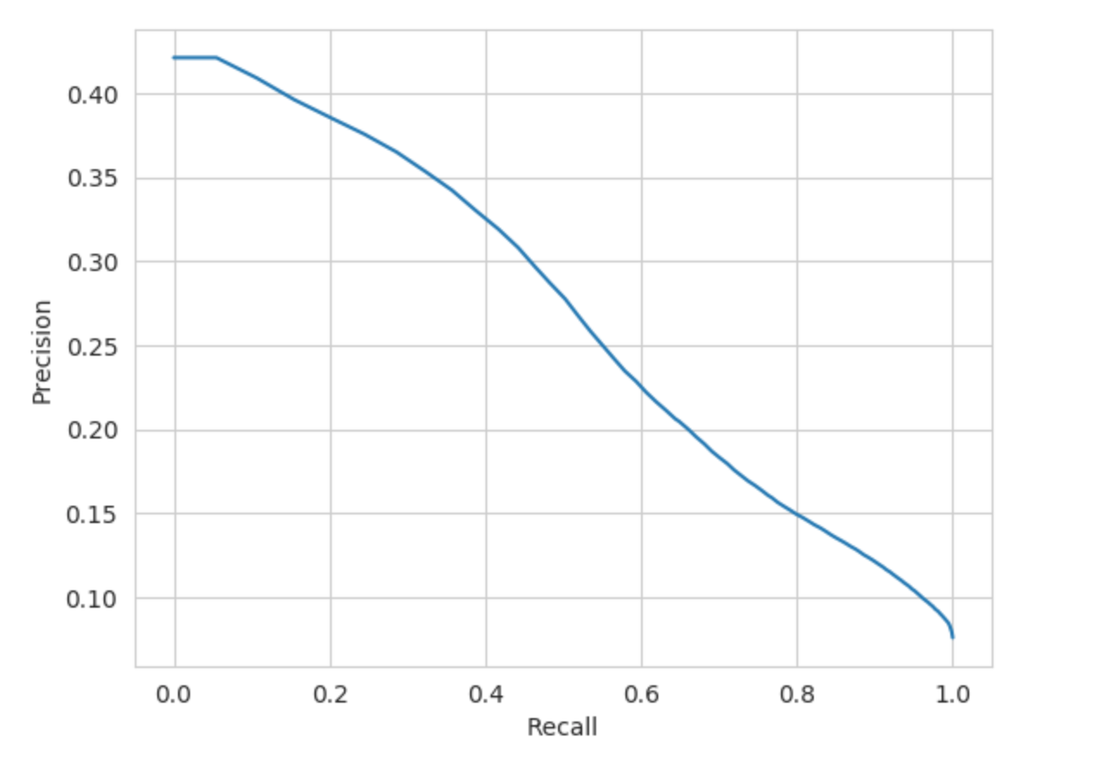
ROC Curve and Precision-Recall Curve

Slide 20
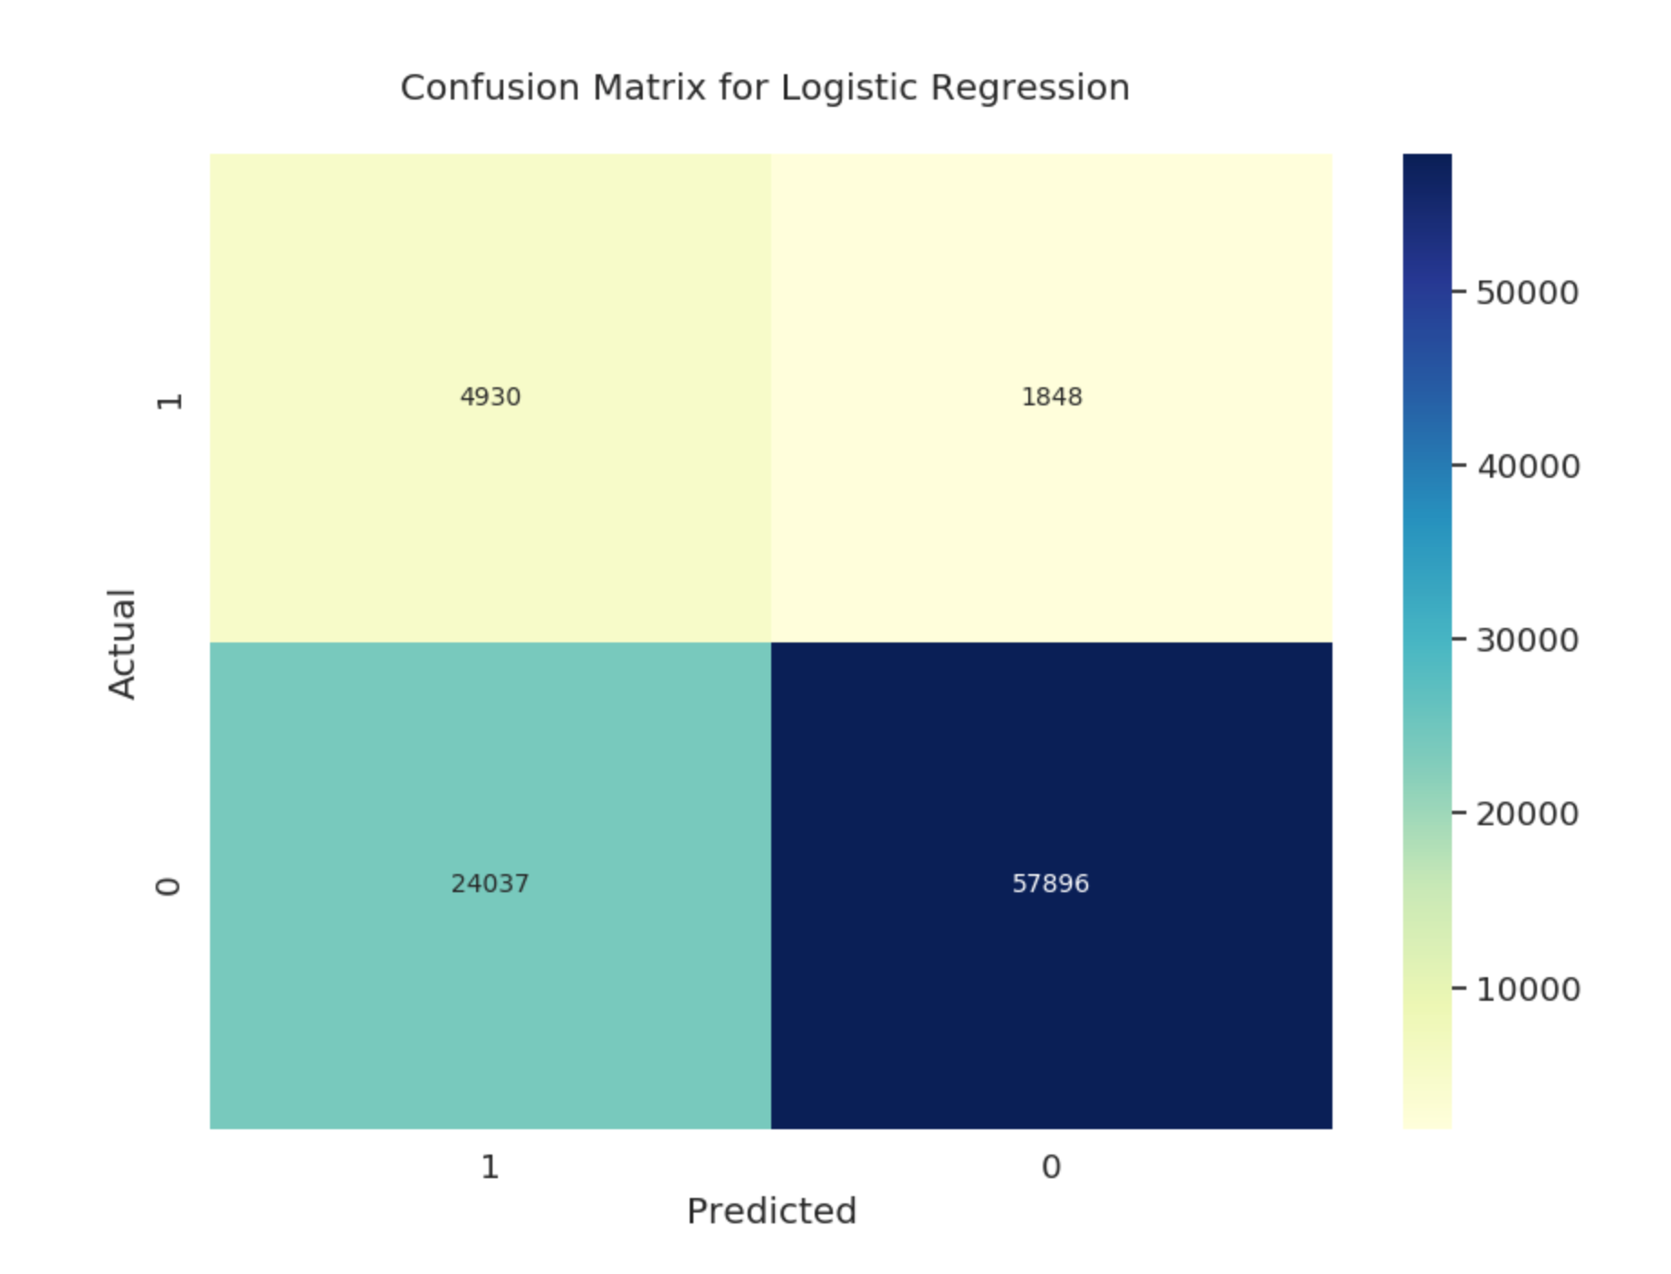
Confusion Matrix

Slide 21

Decision Tree
Goal: To create a model with better accuracy than a logistic regression.
Decision Tree Classifier was used with the features inspired from Logistic Regression aimed to achieve a higher accuracy
Techniques used to handle class imbalance:
1. Under Sampling:
Result: The AUC with default model 69%
The AUC with best model 71%
2. Stratified Sampling
Result: The AUC with default mode is 60.9%
The AUC with best model is 72.7%

Slide 22
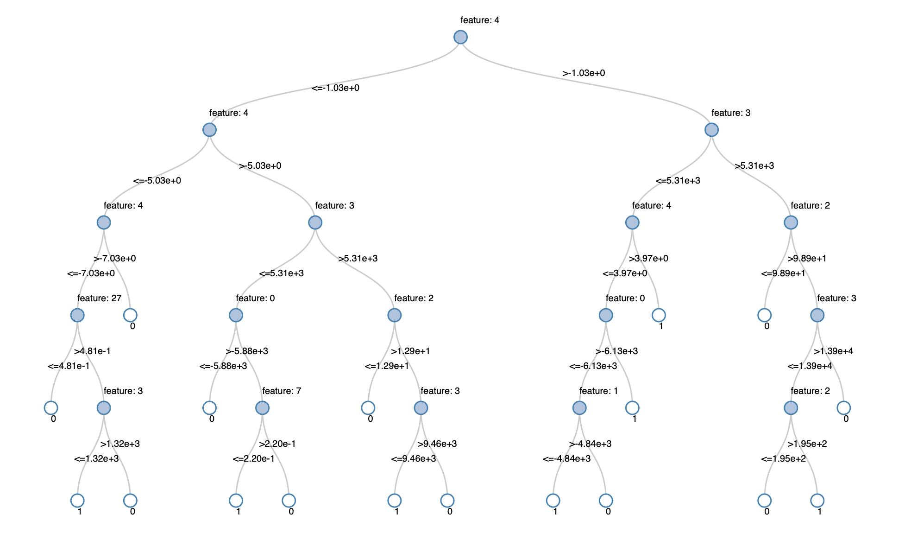
Tree

Slide 23
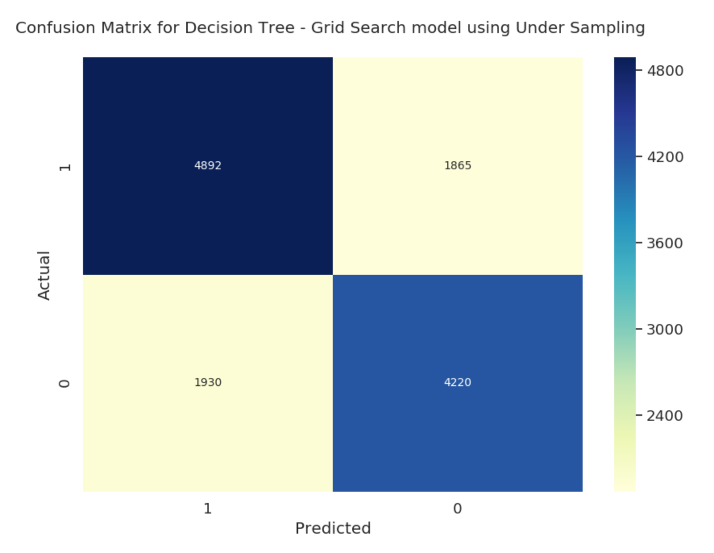
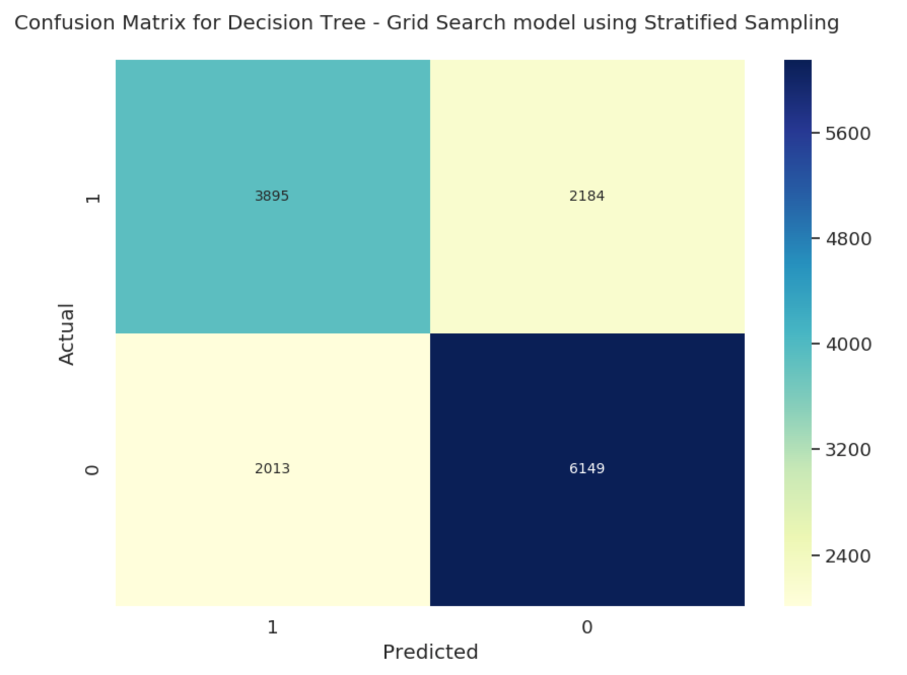
Confusion Matrix for both the sampling methods

Slide 24
Random Forest
Goal: To create a model with better accuracy than a logistic regression and decision tree
Random Forest Classifier was used with the features inspired from Decision Tree aimed to achieve a higher accuracy
Result:
The AUC score on default model: 82%
The AUC score on Grid Search best Model: 85.5%

Slide 25
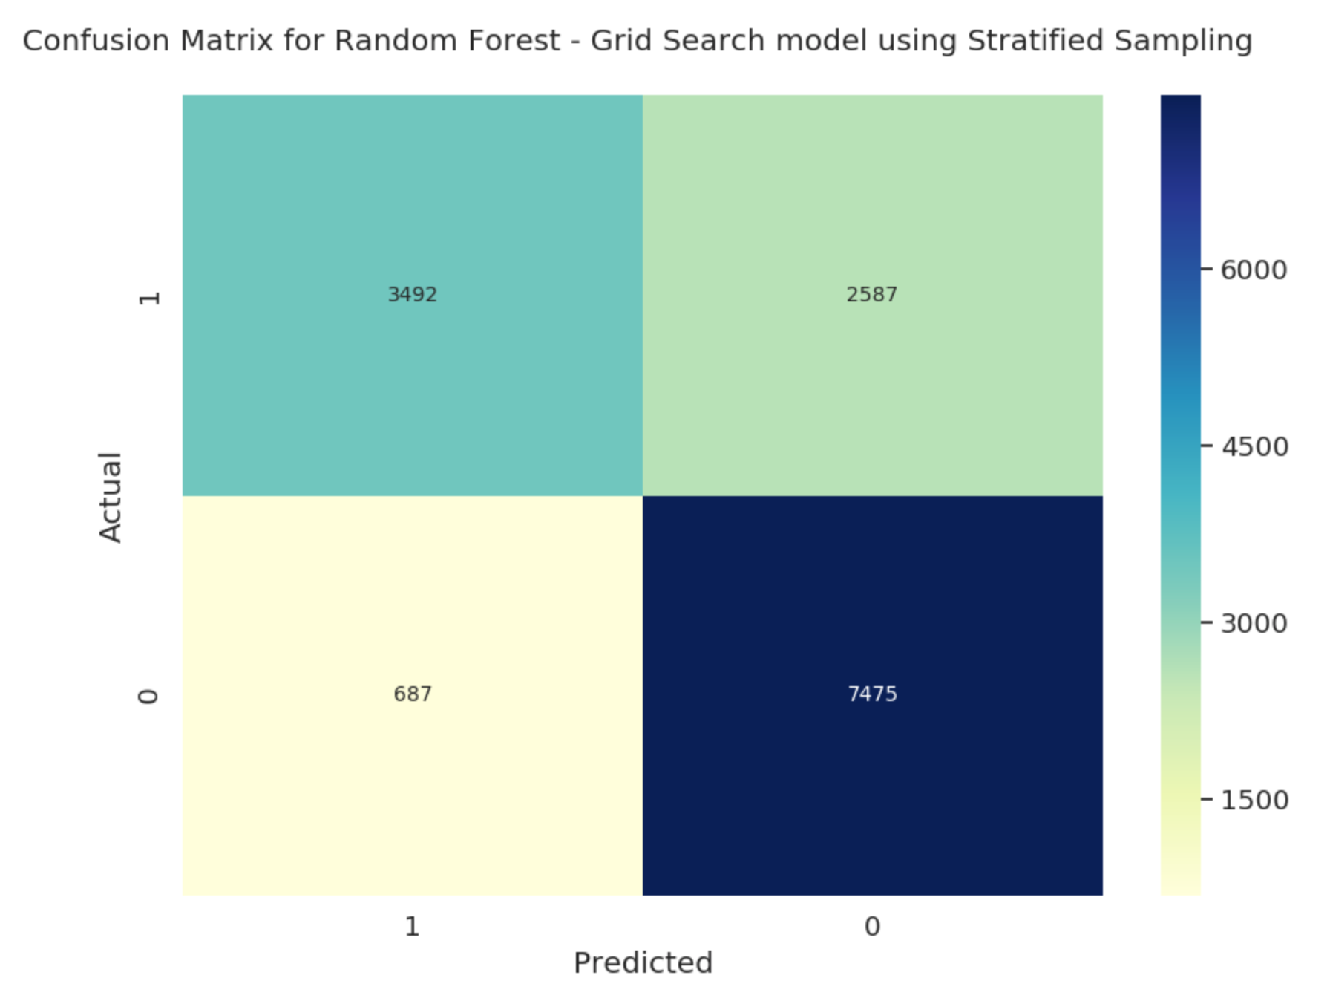
Confusion Matrix

Slide 26
Inference

Slide 27
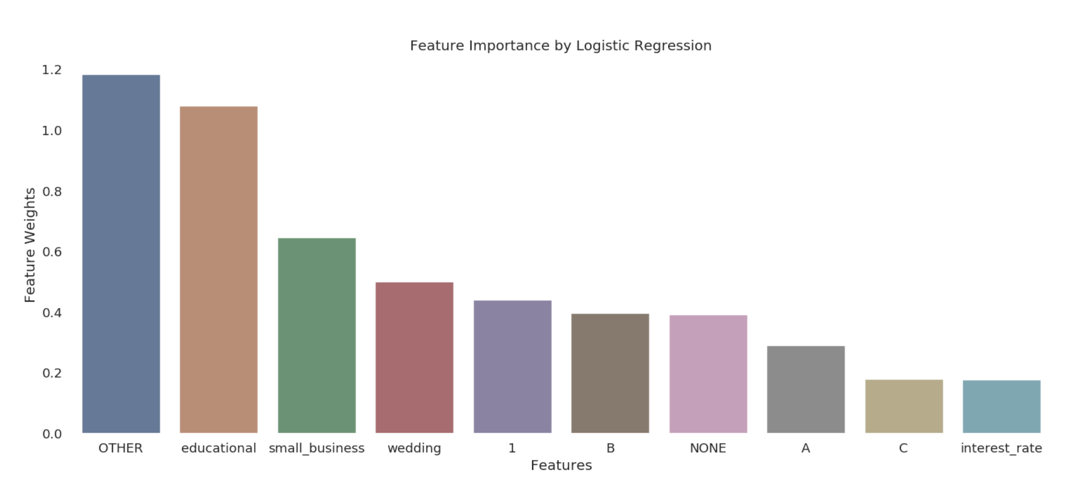
Feature Importance of Logistic Regression

Slide 28
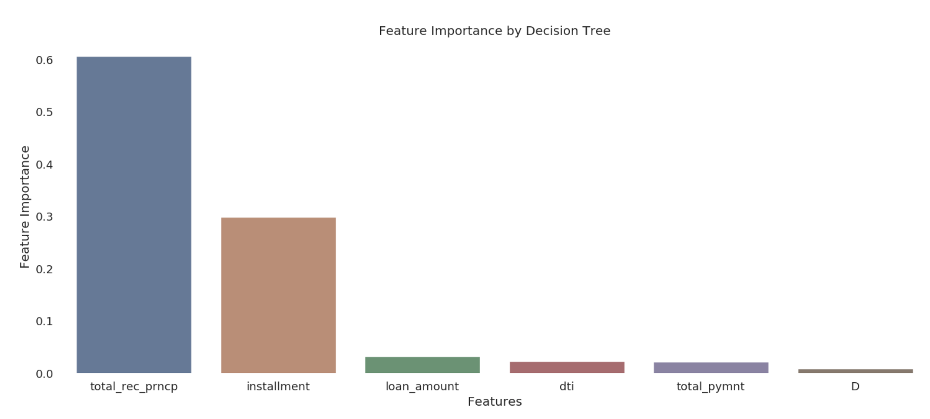
Feature Importance by Decision Tree

Slide 29
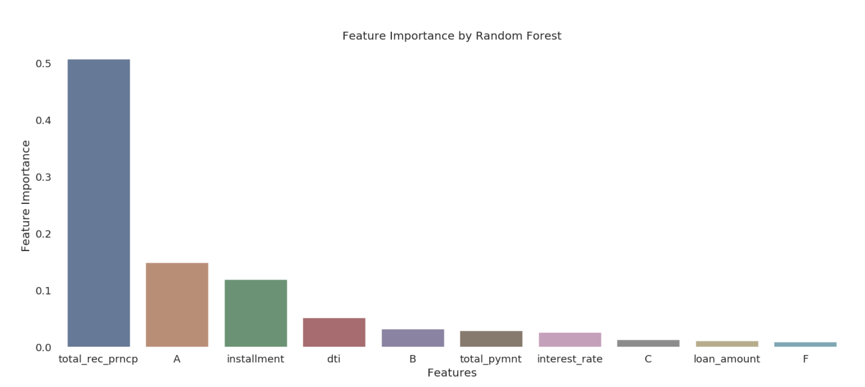
Feature Importance by Random Forest

Slide 30
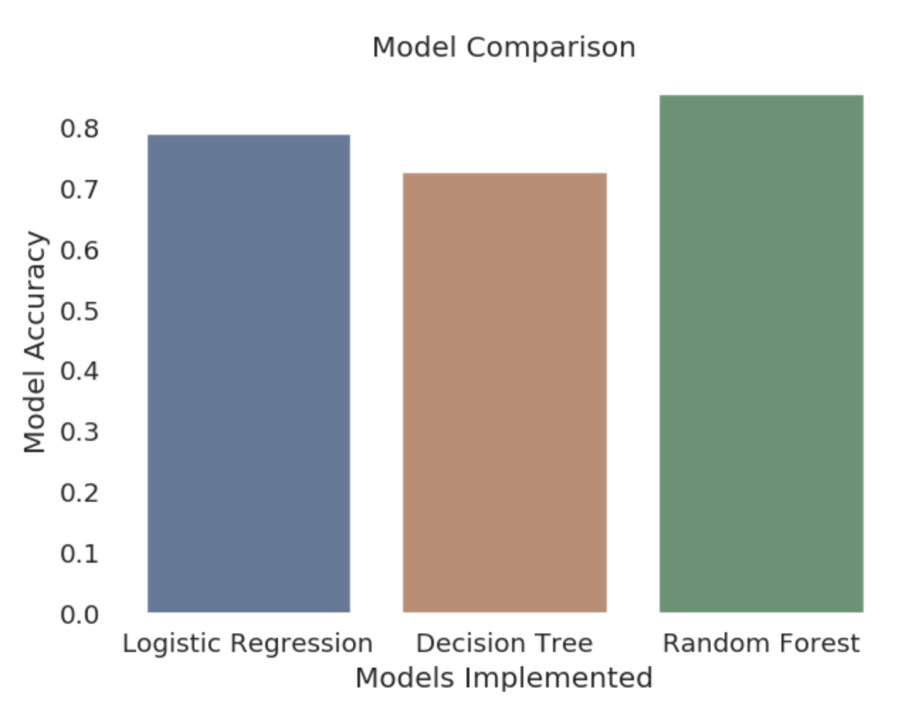
Model Comparison

Slide 31
Bottlenecks
Class imbalance in the dataset
Feature Selection
Poor Accuracy Rate
Limited Computational Power

Slide 32
Contribution
Dharmik Kothari
Logistic Regression
Soham Adhikari
Random Forest Classifier
Yash Pasar
Decision Tree
Data Cleaning and Exploratory Analysis were done by all the members
Presentation and Report was also done by all the team members

Slide 33

Thank You!

